Slide 1
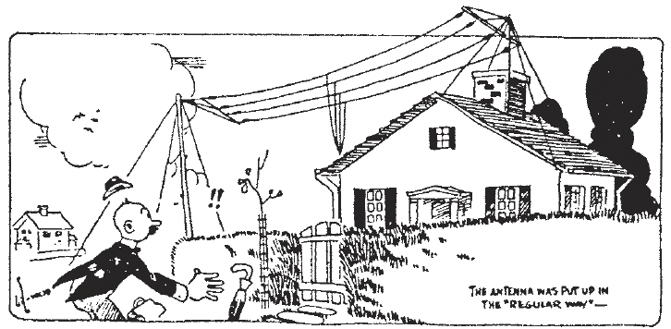
HF Station Considerations
Bill Shanney, W6QR

Slide 2
Who Am I?
I’m a retired EE who loves HF operating
I live on a small lot (75x75’) with a big house that covers most of the property
My shack is on the second floor which presents several challenges
My antenna solution is stacked dipoles. Its not perfect, but I understand my limitations
Since I am in close proximity to my antennas, I have RF in my shack
This is called the Near Field, closer than one ƛ

Slide 3
Summary
Antennas
Efficient, trouble-free station
Recent portable antenna results

Slide 4
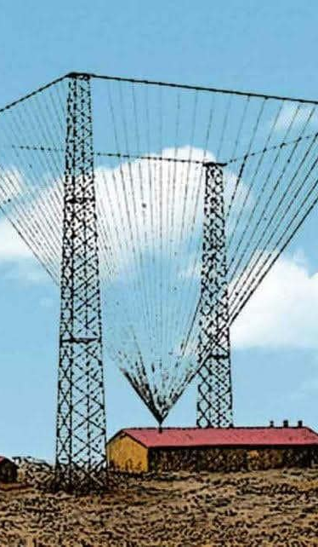
Overview
Your antenna is the most important part of your HF station
Virtually any transceiver manufactured in the past 20 years will provide a new ham many contacts
A poor antenna will limit both transmit and receive performance
This presentation is oriented to new hams putting up antennas that will provide the most contacts
As solar cycle 25 diminishes antenna requirements change

Slide 5
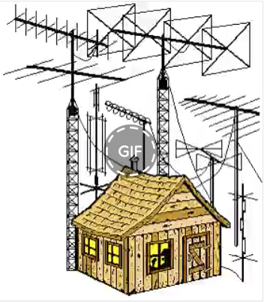
Questionable Advice
In the past I was told to put my antenna as high as possible
That is good advice for DX but may limit your ability to make close in contacts
A better approach might be to put your antenna at a height that balances DX and local contacts
Understanding the capability of your antennas is very useful

Slide 6
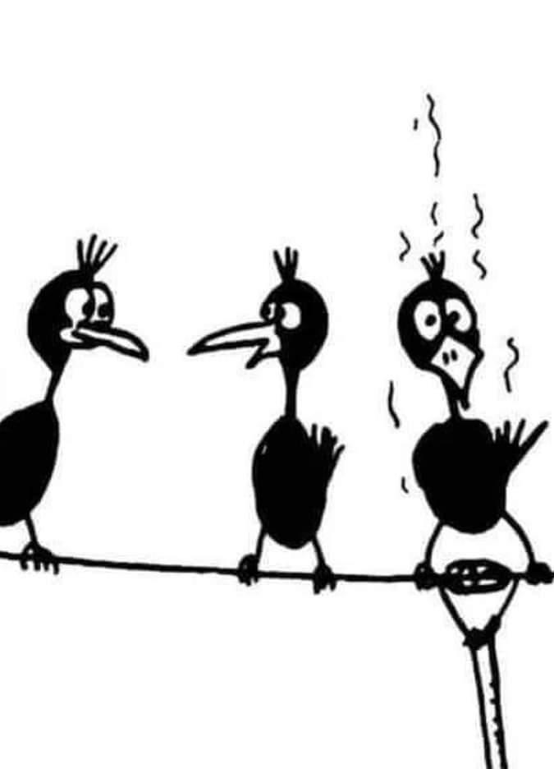
My Thought Process
Everyone has different interests and constraints
I enjoy working DX stations but enjoy rag chewing more. I want my antennas to have good low angle performance for DXing but not at the expense of close in contacts
Dipoles provide a good compromise. I have pulleys at different heights on my 45’ mast so I can move my dipoles up and down to optimize performance during solar max and min
Verticals present a challenge for small lots. You need to mount it clear of structures. Putting it up too high reduces low angle gain.

Slide 7
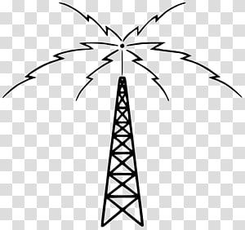
How Close Can You Contact?
We will begin by discussing the critical frequency which limits close in propagation
In propagation predictions we need to understand that the most commonly used numbers have a 50% probability
The critical and maximum usable frequencies are the most important factors to understand

Slide 8
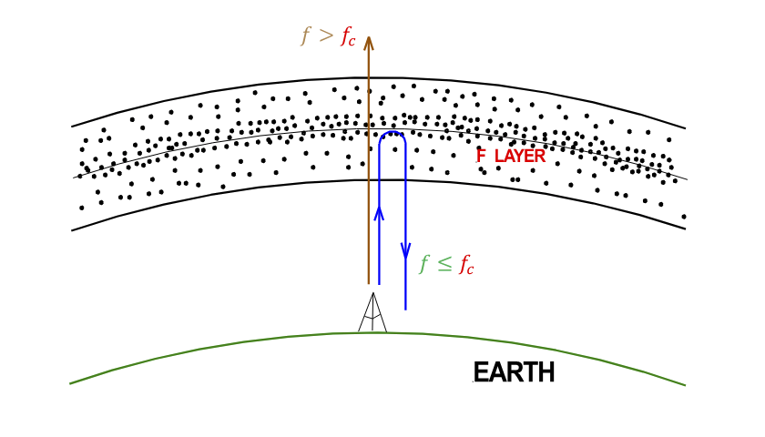
Critical Frequency
The Critical Frequency f_{c} is the highest frequency that can be transmitted straight up and be reflected back to Earth. This limits local contacts to frequencies <f_{c.}

Slide 9
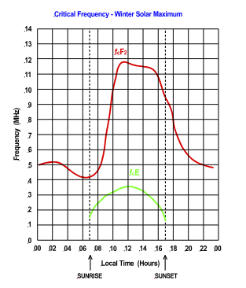
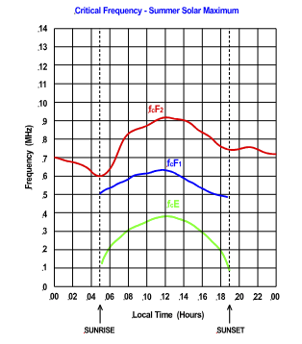
Critical Frequency
Many of you may have noticed poor propagation for local signals early in the mornings and evenings
This is due to a low critical frequency (foF2).
The critical frequency is determined by the amount of ionization in the ionosphere
3-4MHz at night
10-12MHz daytime (Solar max)
Rapid increase after sunrise (7-10AM)

Slide 10
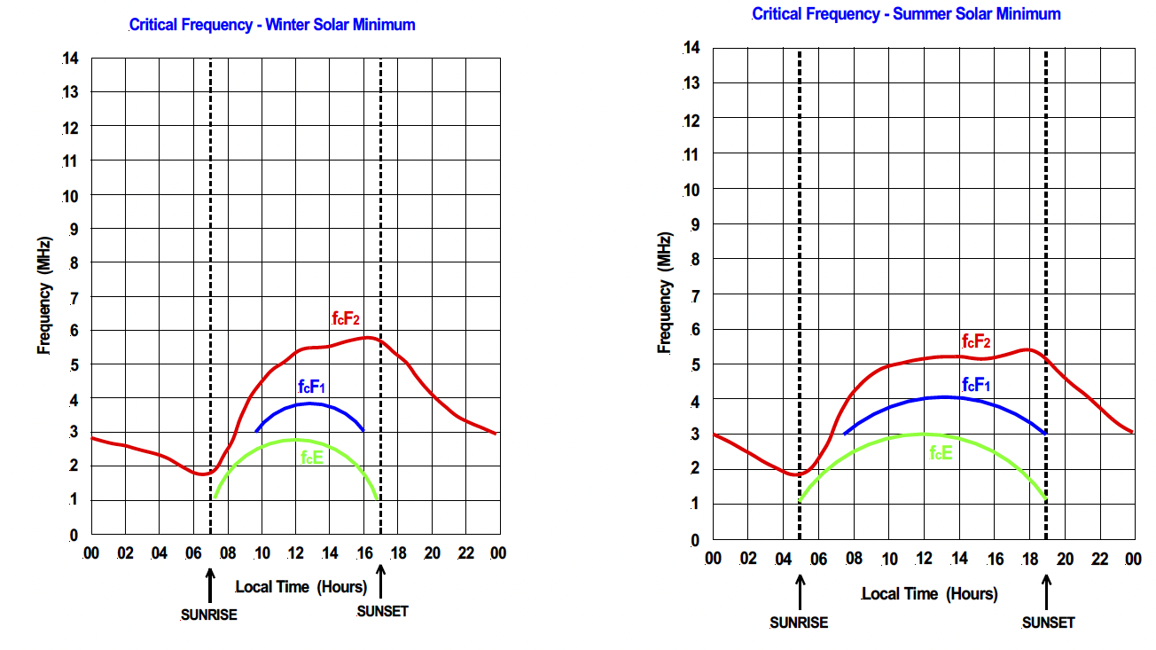
Critical Frequency
Winter
Summer
Solar
Min
Higher frequency reflections do take place at lower elevation angles. The maximum usable frequency (MUF) at a given elevation angle is foF2/Sin(elevation angle) or foF2/cos(zenith angle)
The Critical Frequency in the middle of the reflection path determines the MUF for that path
3000km MUF and Critical Frequency (foF2) can be found at: https://prop.kc2g.com/

Slide 11
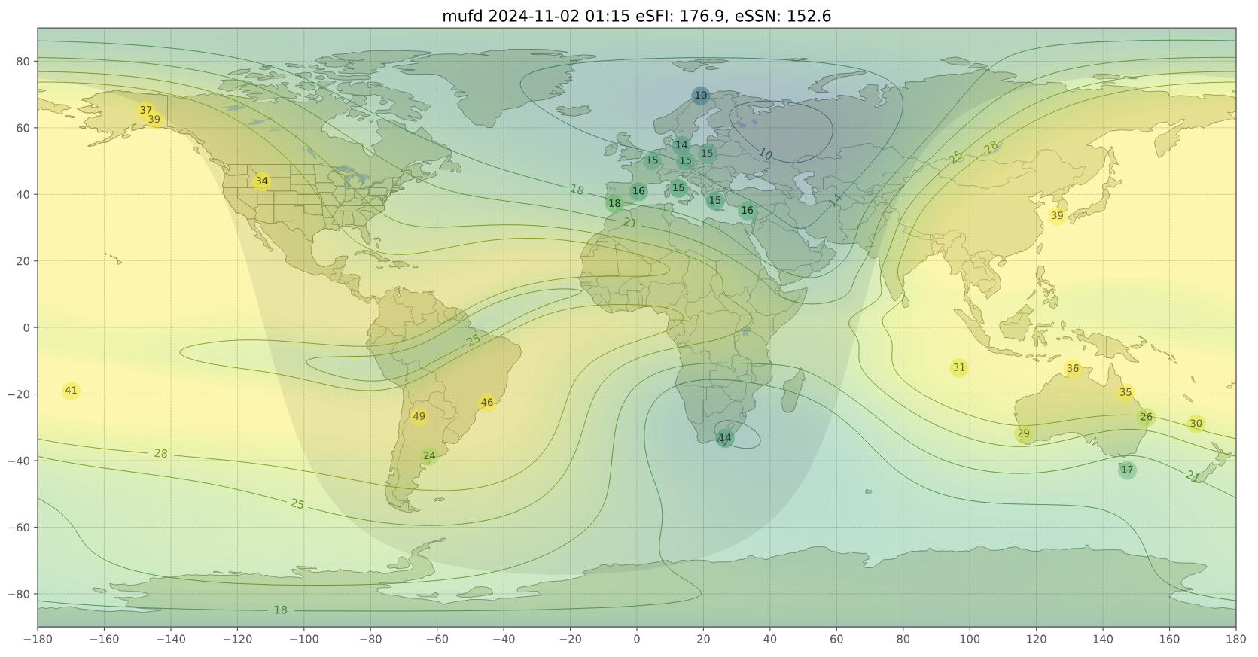
MUF
https://prop.kc2g.com/

Slide 12
Band Considerations
I’m going to limit my discussion to 40-10M. A 40M dipole is roughly 68’ long and can fit straight on most lots. Don’t be afraid to bend the ends to fit
40M is useful all day for local contacts and distant contacts after sundown
Just before 2025 Field Day there was a very interesting article in June QST about antenna height: Maximize Your ARRL Field Day Performance, By Frank Donovan, W3LPL, and Rol Anders, K3RA.
They conclude that 40’ is the most desirable height for a 40M dipole

Slide 13
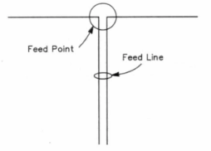
Horizontal Polarization
I’ll talk about horizontally polarized antennas first since they provide more gain and have better radiation at high angles for close in contacts (<1000 miles)
The simplest and most popular horizontal antenna is the dipole
The length is typically ƛ/2
The feed point impedance is between 50-100Ω depending on the height above ground
Maximum radiation is at right angles to the wire for lengths <ƛ

Slide 14
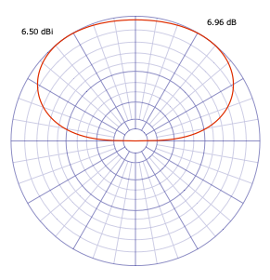
40M Dipole
During Solar Maximum the critical frequency usually goes >7MHz during the day so very high radiation angles are useful. In the evening when the critical frequency drops below 7MHz low angle radiation is desirable
A 20º radiation angle results in a 1200 mile skip distance or 2 hops across the USA
40M Dipole up 40’

Slide 15
Higher Frequency Bands
40M is a very good band for close contacts but has high D-layer absorption during the day which limits multi hop contacts. The D-layer goes away at night
20M is a good band for longer distance contacts at any point in the solar cycle. The critical frequency at solar max limits close in contacts to >400 miles. At solar minimum this becomes >800 miles.
At solar max 20M can stay open into the evening for low angle DX contacts
We want to mount our dipole low enough to make the 400-mile contacts, elevation angle 60º, but high enough to have reasonable performance at 10º elevation for DXing
25’ is a good compromise height

Slide 16
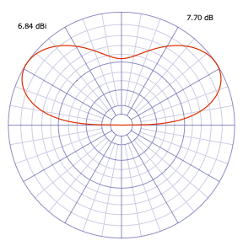
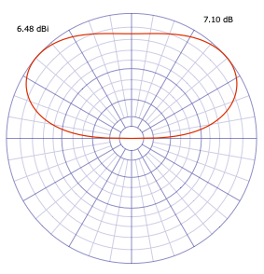
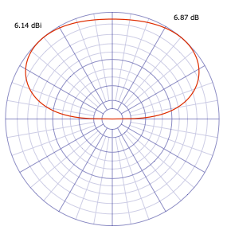
20M Dipole
Dipole performance vs Height is shown below
Dipole up 35’
Dipole up 25’
Dipole up 18’
A 20M Dipole up 25’ has a good balance of low and high angle radiation

Slide 17
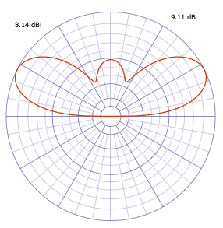
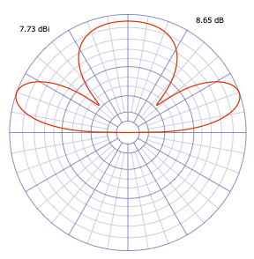
15 and 10M Bands Near Solar Max
The short skip on 15M is 600 miles, 45º elevation
On 10M it is 800 miles, 30º elevation
These are both DX bands during solar maximum
Both do well at 25’ high for overall use, see below. Many hams prefer to mount them higher and focus on DX
15M
10M

Slide 18
Close In Propagation Summary
Band | Min Distance Winter |  | Radiation Angle
 | Solar Max | Solar Min | Solar Max | Solar Min
40M | 0 | 500 miles | 90º | 50º
20M | 400 | 800 | 60 | 30
15M | 600 | 1200* | 40 | 20
10M | 800 | 1600* | 30 | 15
These are rules of thumb mid-day based on Critical Frequency
Summer propagation is much worse
* During solar min there might not be enough electron density to support long distance propagation on 15 or 10M

Slide 19
Fresnel Zone
Dipoles get an extra 6dB gain from ground reflections. The area where the reflections take place is called the Fresnel Zone
For a dipole up 25’ the Fresnel Zone is from 14-140’ away from the antenna and about 140’ wide (10-60º elevation angle)
For best performance you want as much clear space in this zone as you can get, especially in directions you want to work
Higher antennas have a larger Fresnel Zone, especially at low elevation angles

Slide 20
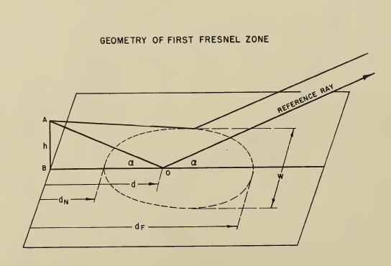
Fresnel Zone
d=h/tan(⍶)

Slide 21
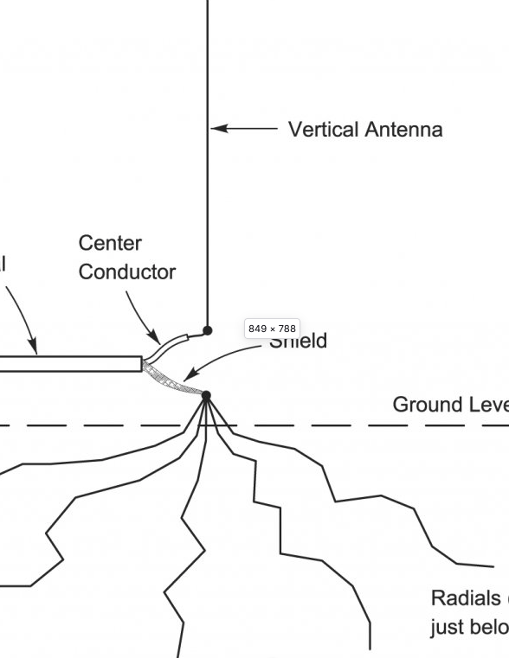
Vertical Antennas
Vertical antennas are great DX antennas. They excel at radiation angles <20º, >1200 miles/hop
Verticals mounted on the ground need a good radial system. 30 radials or more provide low ground loss. Their length is not critical.
Elevated verticals require at least 2 resonant radials per band
Verticals need a clear field of view. Ground mounted between houses they don’t do well. In a park or open field, they perform well
Ground mounted verticals have poor close in performance due to the overhead null

Slide 22
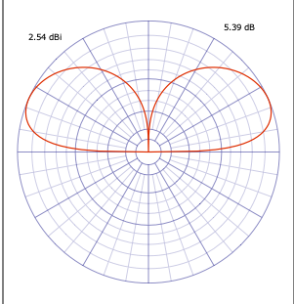
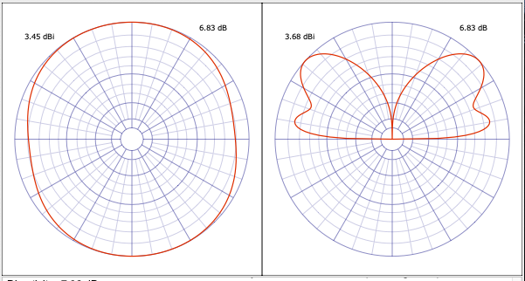
Vertical Radiation Patterns
Raising a vertical high off ground creates
high angle lobes and reduces low angle
radiation.
10M Vertical up 1’
10M Vertical up 20’

Slide 23
Verticals – cont’d
Mounting a vertical too high reduces low angle radiation, creates high angle lobes
<10’ off ground to preserve 10M performance
A vertical Dipole or EFHW does not require radials and is a very good antenna
Multi-band no radial designs are a compromise, but will get you on the air making contacts

Slide 24
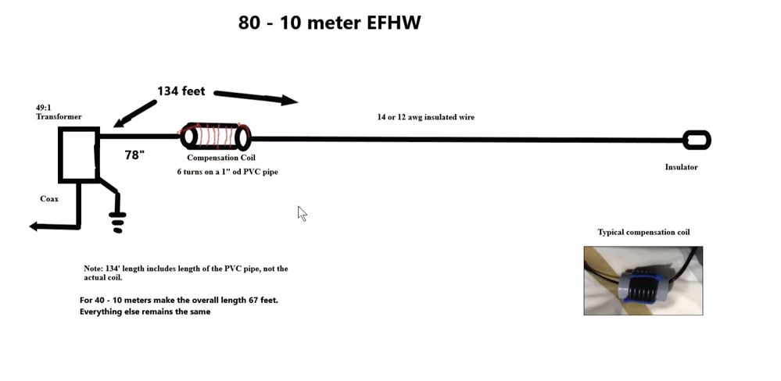
What is an End Fed Half Wave Antenna
Counterpoise
The compensation coil is required to have a proper resonant frequency at harmonics, it compensates for end effects
N4LQ, Steve Ellington, has a lot of data on his Face Book and You Tube pages.
Commercial versions are available for those who don’t like building things
LDG sells an inexpensive low power transformer
The ARRL has a very nice Kit available but does not talk about the coil

Slide 25
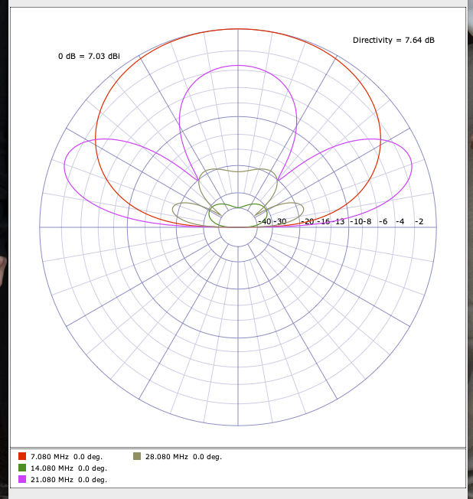
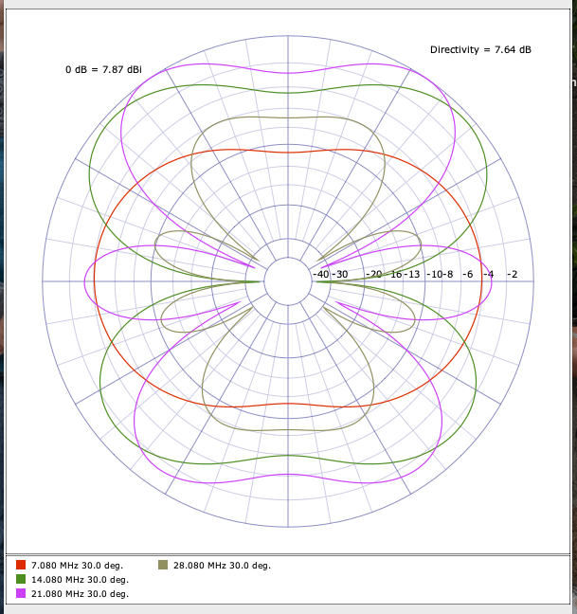
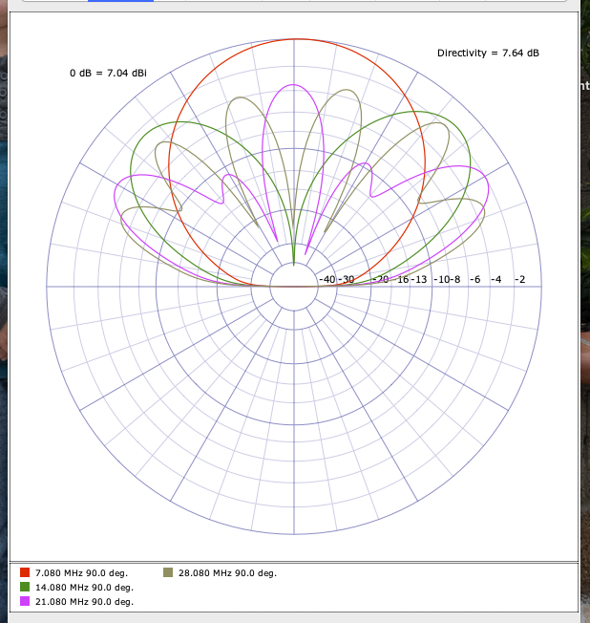
EFHW Radiation Patterns: Horizontal 40M EFHW at 30’
Broadside
Azimuth pattern at 30º elevation
Antenna Oriented up/down
End Fire

Slide 26
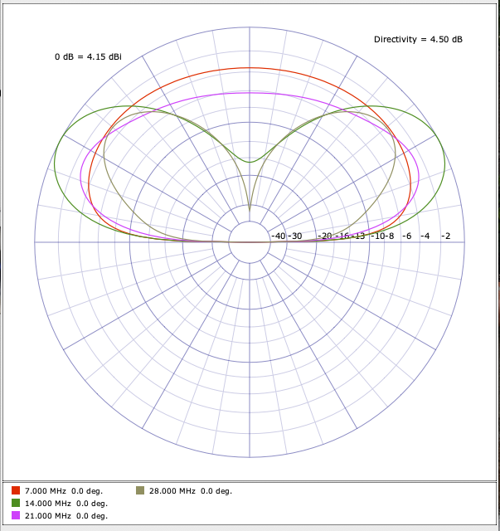
Other Geometries
A sloping dipole has a mix of horizontal and vertical radiation but works well
An Inv-L is a vertical with top loading that eliminates the overhead null. These are popular on the low bands.
An Inv-L EFHW works very well
40M EFHW Inv-L

Slide 27
Station Efficiency
Station Efficiency includes feeding the antenna, taming the RF in your shack and matching the impedance at the end of the coax to 50Ω
Good quality coax is not cheap these days. Amazon coax is a crap shoot. I buy from reputable companies
DX Engineering
ABR Industries
Messi & Paoloni (GigaParts or direct)
1dB of feedline loss reduces your transmit power by 25%

Slide 28
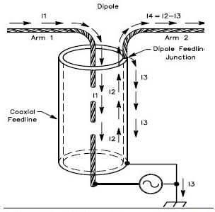
Taming the RF in Your Shack
The first source of RF is common mode current on the outside of the coax shield
All coax entering my shack goes through a line isolator
1:1 Balun
8-10 turns RG-8X on an FT240-31 Ferrite toroid
5 FT240-31 beads on the coax
The isolator should be as close to your tuner or transceiver as possible

Slide 29
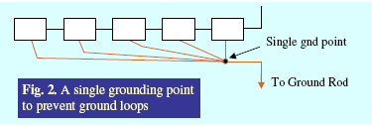
Safety Ground
You should have a safety ground. As short a run as possible of #6 wire or tinned copper braid to a ground rod
All you station equipment should be connected to this ground using a heavy ground bus. This is not an RF ground; the length is too long in most cases.
Connecting all equipment grounds to a common point puts them all at the same RF potential but since most shacks are in the near field of the antennas there will be RF on all station wiring

Slide 30
RF Grounding
Equipment wiring can result in ground loops that can cause RF ‘Hot Spots’ on your operating bench such as hot MICs, Keys, accessories, etc.
The best solution I have found is to provide a very low impedance distributed ground under all my equipment.
This is described in detail in the ARRL book “Grounding and Bonding For the Radio Amateur” by Ward Silver, Chapter 5. I highly recommend this book, available from the ARRL or Amazon.

Slide 31
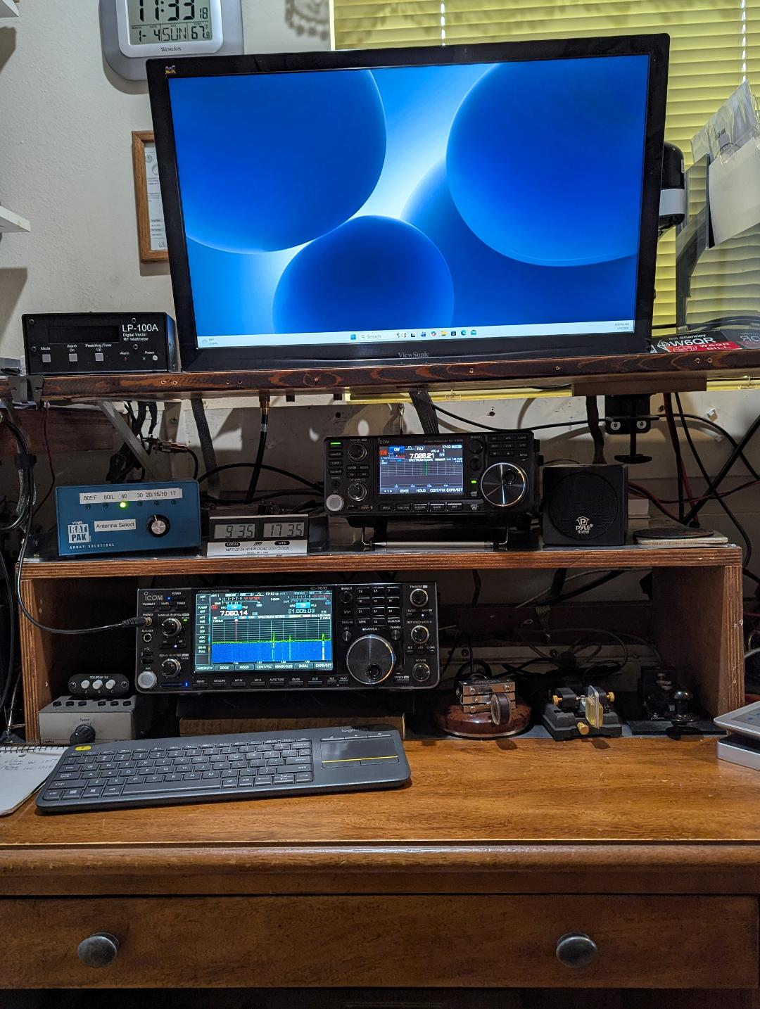
My Shack

Slide 32
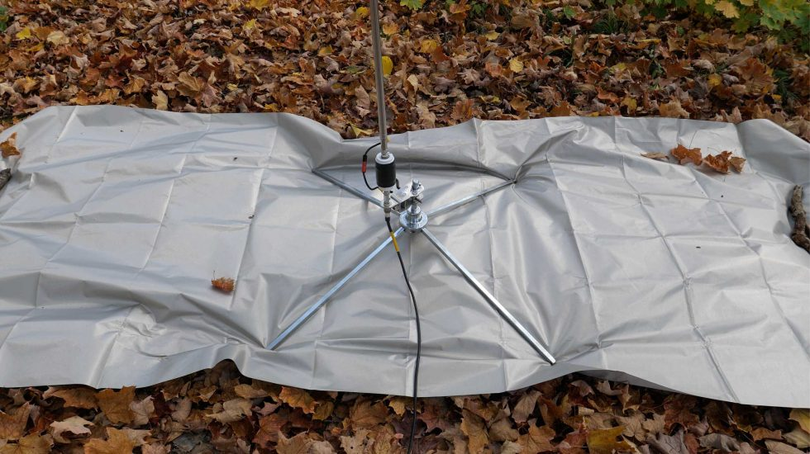
Recent Portable Antenna Results
I’ve been using Faraday Cloth as a counterpoise with my 17’ whip for over a year now
No radial tuning when you change bands
Low VSWR 20-10M
No trip Hazard in local parks

Slide 33
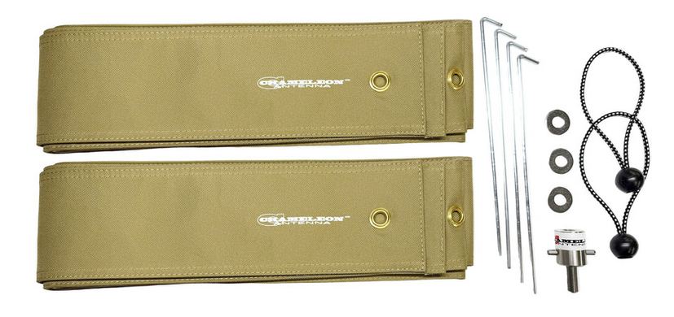
Faraday Strip Radials - FSR
Chameleon recently came out with the FSR. Two 20’ strips of faraday cloth covered by heavy nylon fabric

Slide 34
FSR cont’d
Used in a cross pattern they are usable from 40-10M.
Low VSWR 20-10M 17’ whip, 30-10M 25’ whip
17’ whip + 40M coil VSWR 2.3-3:1
25’ whip + 40M coil VSWR 1.7-2:1
Used end-to-end, two 20’ radials, on 40M
17’ whip + 40M coil VSWR 1.5-2:1
25’ whip + 40M coil VSWR 1.13-1.5:1

Slide 35
Questions?

